Slide 1




Git & GitHub TECHNICAL SESSION
Mohamed Hesham Abdullah - Technical Training Co-Head

Slide 2
Table of contents
01.
02.
03.
What is Git & GitHub?
Terminologies
Getting Started
04.
05.
06.
Repositories
Git Commands
Quiz
Version Control Software VS.
Hosting Service
Familiarizing ourselves with common terms
How to create an account & set up Git on your PC! (Quickly)
How to create a repository & Introducing Git Bash
Fundamental git commands including: add, commit, etc.
Short interactive online quiz through Quizizz
07.
08.
09.
Branches & Pull Requests
Merge Conflicts
Tools, Benefits, & Awareness
Essential feature to start working with a team!
Introducing the problem when dealing with versions & teammates
GitHub Desktop, Azure DevOps, Student Developer Pack, and Future Session Plans!

Slide 3
01
What is Git & GitHub?
Version Control Software VS. Hosting Service

Slide 4
Git - Keeps Track Of Code Changes
a = 1
b = 2
c = 3
Create file

Slide 5
Git - Keeps Track Of Code Changes
a = 1
b = 2
c = 3
a = 1
b = 2
c = 3
d = 4
Create file
Add a Line

Slide 6
Git - Keeps Track Of Code Changes
a = 1
b = 2
c = 3
a = 1
b = 2
c = 3
d = 4
a = 1
b = 2
c = 3
d = 4
Create file
Add a Line
Remove a line

Slide 7
Git - Move Between Different Versions Of Code
(Latest)
a = 1
b = 2
c = 3
a = 1
b = 2
c = 3
d = 4
a = 1
b = 2
c = 3
d = 4
Create file
Add a Line
Remove a line
Current Version

Slide 8
Git - Move Between Different Versions Of Code
(Latest)
a = 1
b = 2
c = 3
a = 1
b = 2
c = 3
d = 4
a = 1
b = 2
c = 3
d = 4
Create file
Add a Line
Remove a line
Current Version (Reverted)

Slide 9
Git - Move Between Different Versions Of Code
(Latest)
a = 1
b = 2
c = 3
a = 1
b = 2
c = 3
d = 4
a = 1
b = 2
c = 3
d = 4
Create file
Add a Line
Remove a line
Current Version (Advanced)

Slide 10


Git - Synchronizes Code Between Different People
a = 1
b = 2
c = 3
b = 2
c = 3
d = 4
b = 2
c = 3

Slide 11
Git - Synchronizes Code Between Different People
a = 1
b = 2
c = 3
b = 2
c = 3
d = 4
a = 1
b = 2
c = 3
d = 4

Slide 12
Git - Synchronizes Code Between Different People
GitHub (Hosts Git Projects)
a = 1
b = 2
c = 3
b = 2
c = 3
d = 4
a = 1
b = 2
c = 3
d = 4

Slide 13
02
Terminologies
Familiarizing ourselves with common terms

Slide 14

Repository
Folder

Slide 15
Repository
Folder
Intialized

Slide 16
Repository
Folder
Intialized
Repository

Slide 17
Local vs. Remote
Your PC

Slide 18
Local vs. Remote
Your PC
Local

Slide 19
Local vs. Remote
GitHub
Your PC
Local

Slide 20
Local vs. Remote
GitHub
Your PC
Local
Remote

Slide 21
03
Getting Started
How to create an account & set up Git on your PC! (Quickly)

Slide 22
Creating An Account On GitHub
Open GitHub
(github.com)

Slide 23
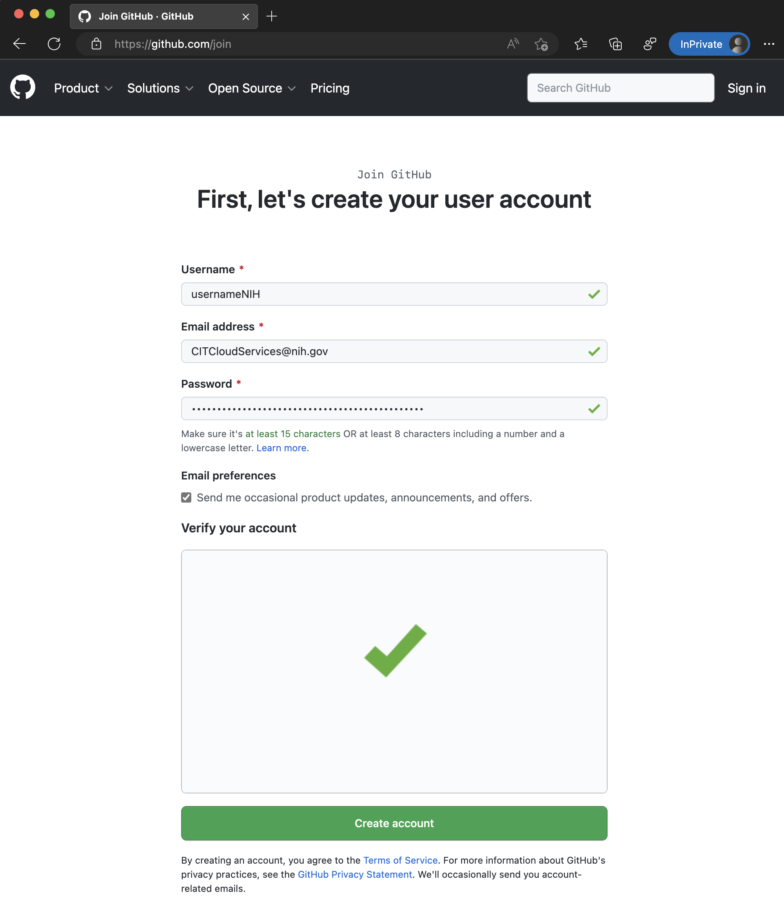
Creating An Account On GitHub
Open GitHub
(github.com)

Slide 24
Creating An Account On GitHub
Open GitHub
(github.com)
Done!

Slide 25
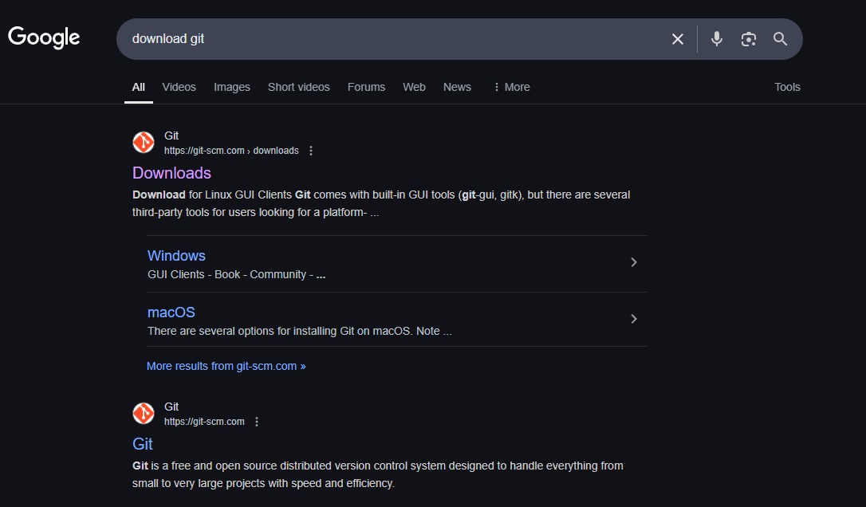
Git Setup

Slide 26
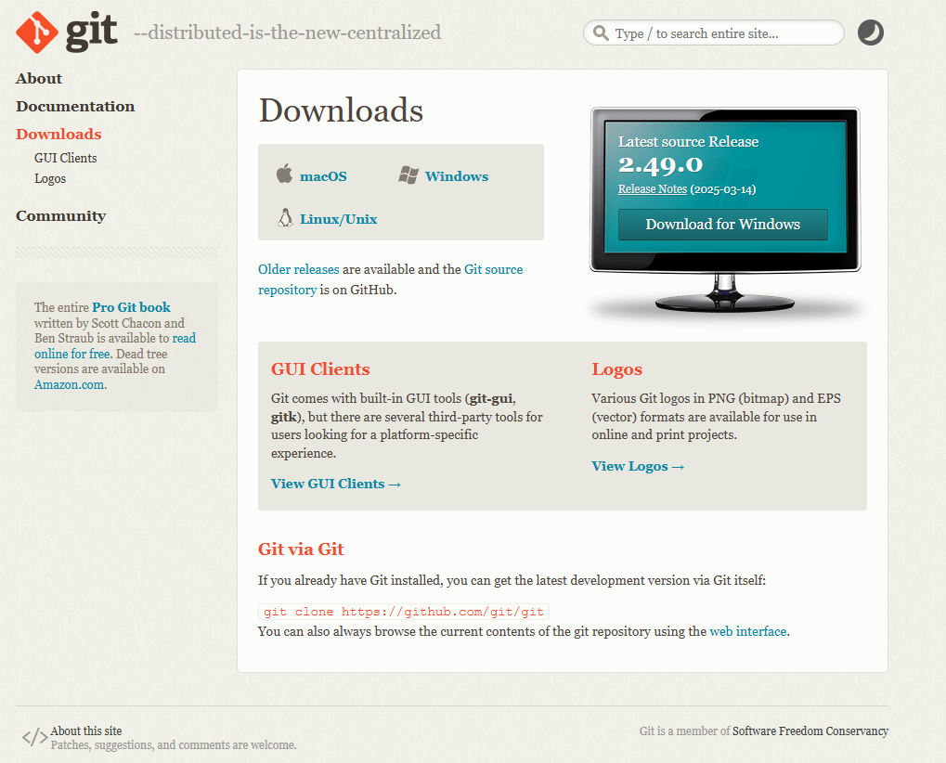
Git Setup
Download From Here

Slide 27

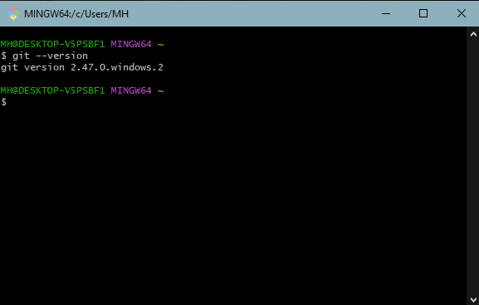
Git Setup

Slide 28
04
Repositories
How to create a repository & Introducing Git Bash
(Practical Presentation)

Slide 29
Repositories
Your PC
git remote add origin URL.git
GitHub
URL/Link

Slide 30
Repositories
Add a remote variable
Your PC
git remote add origin URL.git
GitHub
URL/Link

Slide 31
Repositories
Add a remote variable
Your PC
git remote add origin URL.git
Create an alias called ‘origin’ for this URL
GitHub
URL/Link

Slide 32
05
Git Commands
Fundamental git commands including: add, commit, etc.

Slide 33
git add

Slide 34
GitHub
Your PC
test.cpp
a = 1
b = 2
c = 3

Slide 35
GitHub
Your PC
test.cpp
a = 1
b = 2
c = 3
d = 4

Slide 36
GitHub
Your PC
test.cpp
a = 1
b = 2
c = 3
d = 4
Changes to be committed:
modified: test.cpp

Slide 37
GitHub
Your PC
test.cpp
a = 1
b = 2
c = 3
d = 4
git add
Changes to be committed:
modified: test.cpp
Staging Area
(Store temporarily in a draft space)

Slide 38
git commit

Slide 39
GitHub
Your PC
a = 1
b = 2
c = 3
d = 4

Slide 40
GitHub
Your PC
a = 1
b = 2
c = 3
d = 4
git commit -m “Add Line”

Slide 41
GitHub
Your PC
a = 1
b = 2
c = 3
a = 1
b = 2
c = 3
d = 4
git commit -m “Add Line”
“Add Line”
New Version Created!
(Take a snapshot of code to save it permanently)

Slide 42
git push
Previous commands happend locally, how do we save our stuff remotely?

Slide 43
GitHub
Your PC
a = 1
b = 2
c = 3
a = 1
b = 2
c = 3
d = 4
“Add Line”

Slide 44
GitHub
a = 1
b = 2
c = 3
a = 1
b = 2
c = 3
Your PC
a = 1
b = 2
c = 3
a = 1
b = 2
c = 3
d = 4
git push
“Add Line”

Slide 45
GitHub
a = 1
b = 2
c = 3
d = 4
a = 1
b = 2
c = 3
a = 1
b = 2
c = 3
“Add Line”
Your PC
a = 1
b = 2
c = 3
a = 1
b = 2
c = 3
d = 4
git push
“Add Line”

Slide 46
06
Quiz
Short interactive online quiz through Quizizz

Slide 47
07
Branches & Pull Requests
Essential feature to start working with a team!

Slide 48
first commit

Slide 49
first commit
changes
more changes

Slide 50
master
first commit
changes
more changes

Slide 51
start new feature
test-branch
master
first commit
changes
more changes

Slide 52
Keep working on new feature
start new feature
test-branch
master
first commit
changes
more changes

Slide 53
Keep working on new feature
start new feature
test-branch
master
first commit
changes
more changes
fix bug

Slide 54
Keep working on new feature
start new feature
test-branch
Opened a pull request (PR)
master
first commit
changes
more changes
fix bug
merge

Slide 55
08
Merge Conflicts
Introducing the problem when dealing with versions & teammates
(Explained Practically)

Slide 56
09
Tools, Benefits, & Awareness
GitHub Desktop, Azure DevOps, Student Developer Pack, and Future Session Plans!

Slide 57
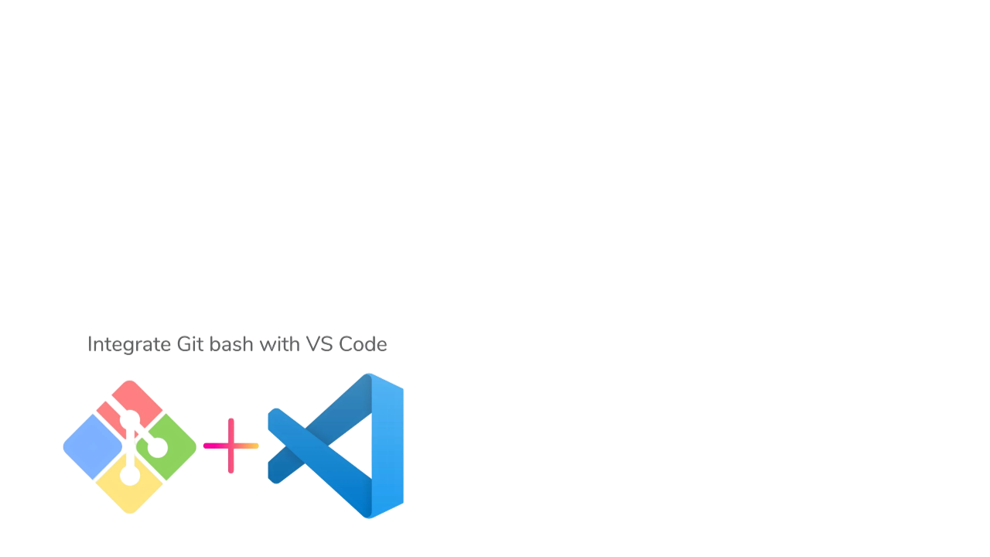

Helpful Tools

Slide 58
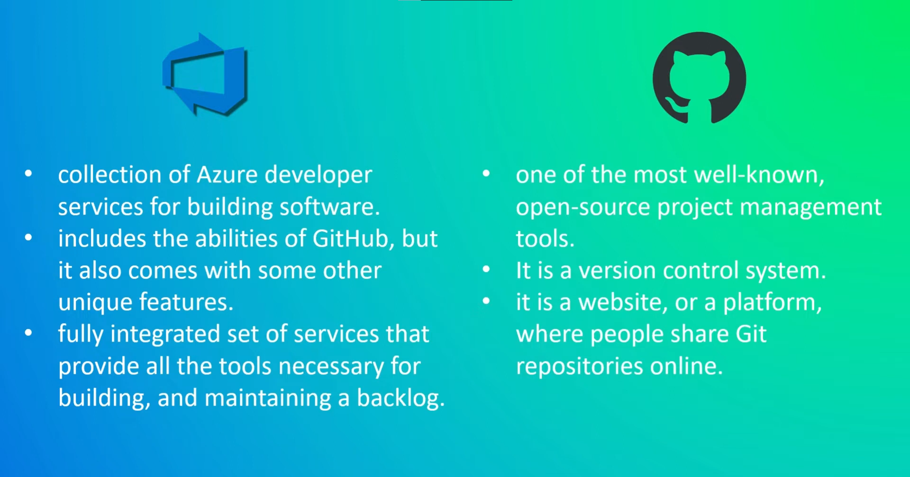
Raising Awareness - Azure DevOps

Slide 59
Other Concepts - Future Sessions
Personalizing Your GitHub for your Resume
README.MD’s
GitHub Apps & Bots (Automation!)
GitHub Pages
Forks VS. Branches
Issues
Codespaces
Tags, Releases, & Milestones
Licenses

Slide 60
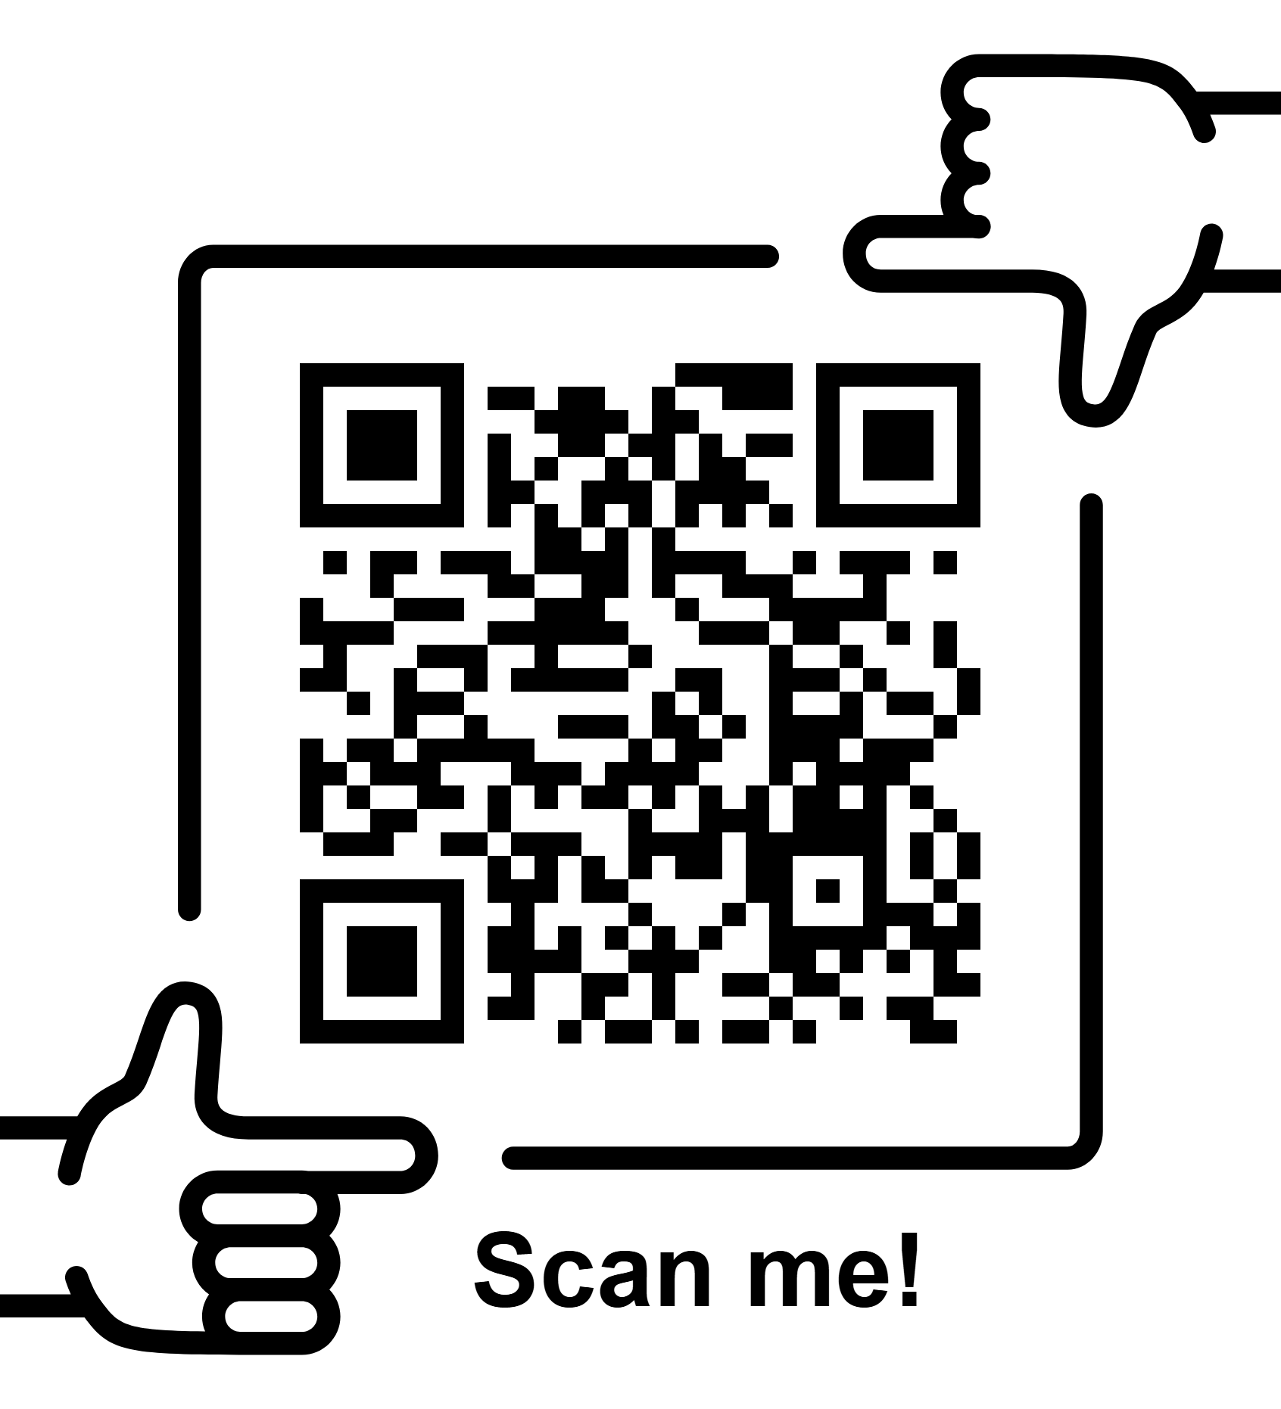
GitHub Student Developer Pack

Slide 61
Thank you!
Do you have any questions?
mohamed2300428@miuegypt.edu.eg
Follow me on GitHub: mohamedelziat50
(https://github.com/mohamedelziat50)

